Slide 1
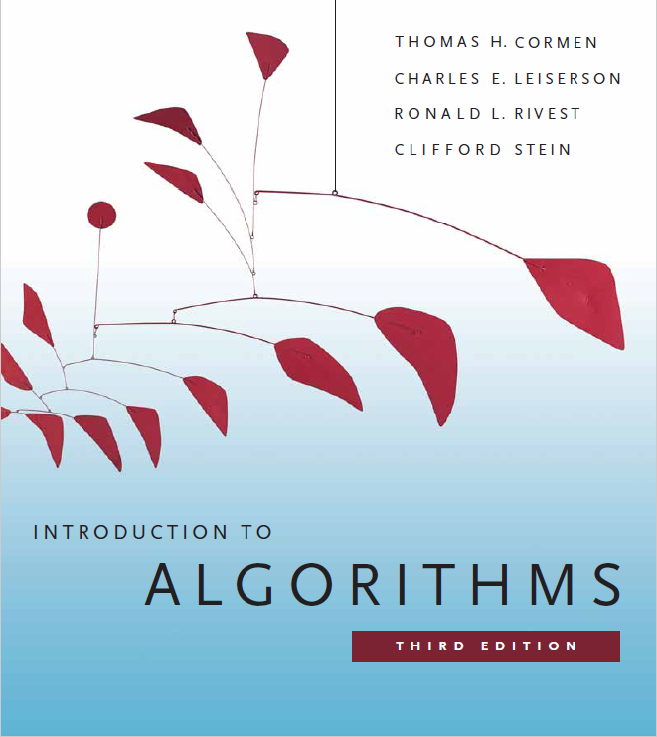
Search Trees
Prepared by Shmuel Wimer
Courtesy of Prof. Dror Rawitz

Slide 2
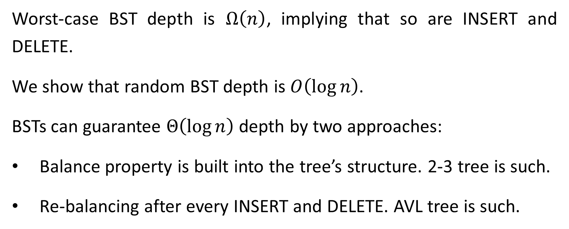
BST Complexities
Worst-case BST depth is $Ω\left(n\right)$, implying that so are INSERT and DELETE.
We show that random BST depth is $O\left(\log{n}\right)$.
BSTs can guarantee $Θ\left(\log{n}\right)$ depth by two approaches:
Balance property is built into the tree’s structure. 2-3 tree is such.
Re-balancing after every INSERT and DELETE. AVL tree is such.

Slide 3
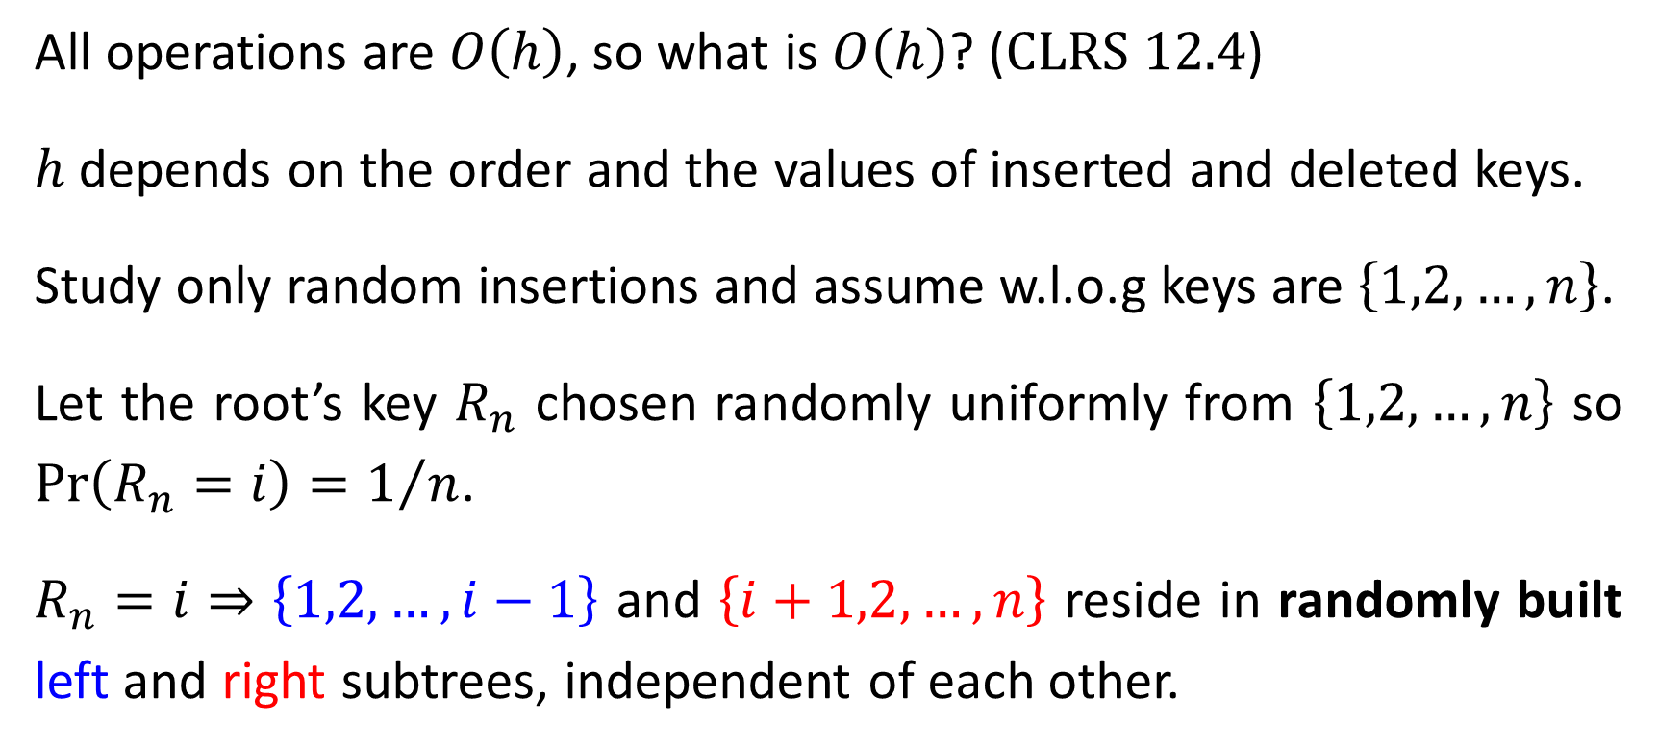
Random BSTs
All operations are $O\left(h\right)$, so what is $O\left(h\right)$? ($\text{CLRS} \text{12.4}$)
$h$ depends on the order and the values of inserted and deleted keys.
Study only random insertions and assume w.l.o.g keys are $\left\{1,2,…,n\right\}$.
Let the root’s key $R_{n}$ chosen randomly uniformly from $\left\{1,2,…,n\right\}$ so $\text{Pr}\left(R_{n}=i\right)=1/n$.
$R_{n}=i$ ⇒ $\left\{1,2,…,i−1\right\}$ and $\left\{i+1,2,…,n\right\}$ reside in randomly built left and right subtrees, independent of each other.

Slide 4

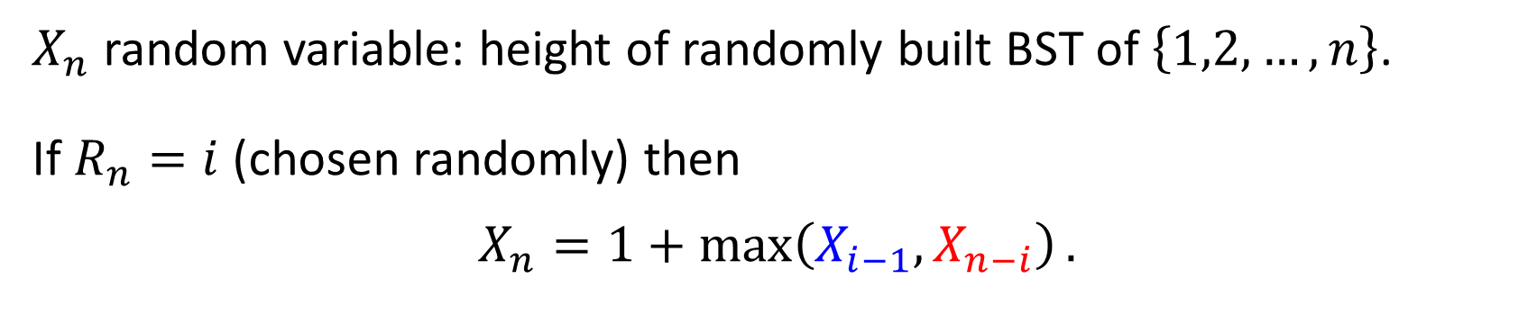





$X_{n}$ random variable: height of randomly built BST of $\left\{1,2,…,n\right\}$.
If $R_{n}=i$ (chosen randomly) then
$$X_{n}=1+\max\left(X_{i−1},X_{n−i}\right).$$
$$i$$
$$X_{n}$$
$$X_{i−1}$$
$$X_{n−i}$$
$$\left\{1,…,i−1\right\}$$
$$\left\{i+1,…,n\right\}$$

Slide 5
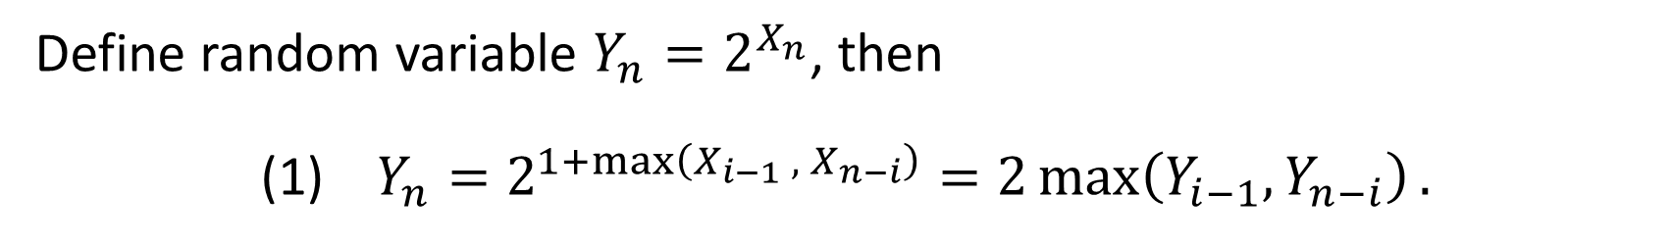
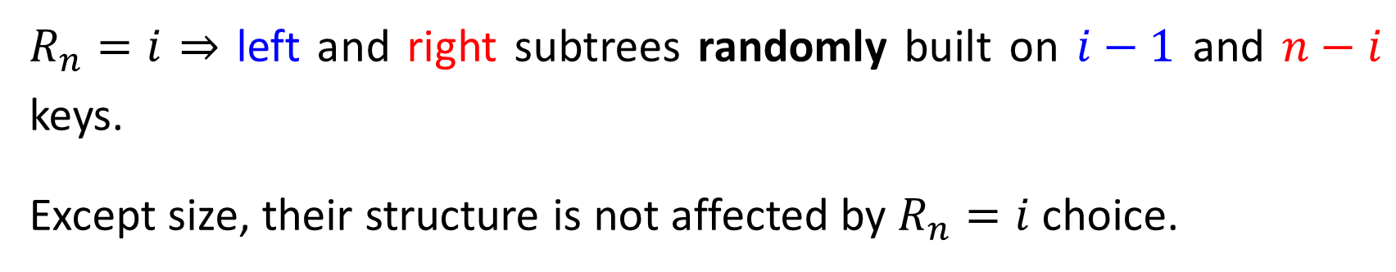
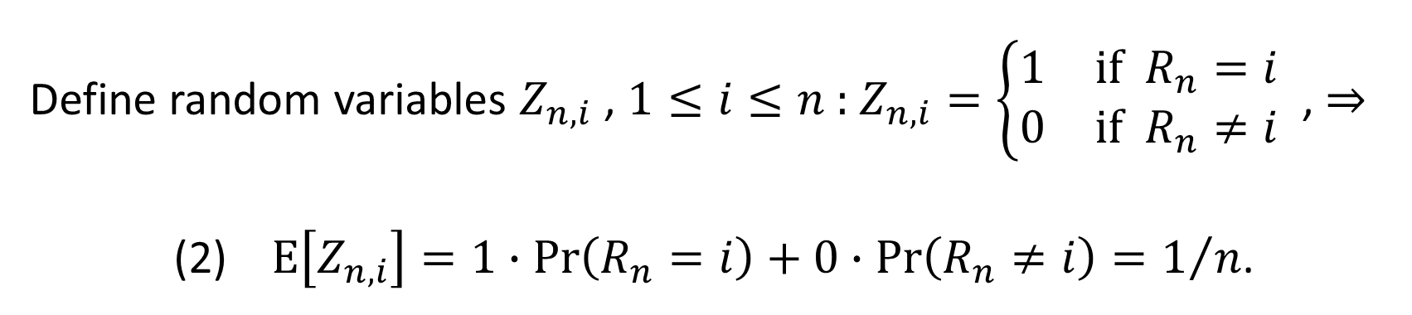
Define random variable $Y_{n}=2^{X_{n}}$, then
(1) $Y_{n}=2^{1+\max\left(X_{i−1} , X_{n−i}\right)}=2\max\left(Y_{i−1},Y_{n−i}\right).$
Define random variables $Z_{n,i}$ , $1≤i≤n$: $Z_{n,i}=\left\{\begin{matrix}1 & \text{if}{ R}_{n}=i \\ 0 & \text{if}{ R}_{n}≠i\end{matrix}\right.$ , ⇒
(2) $E\left[Z_{n,i}\right]=1∙\text{Pr}\left(R_{n}=i\right)+0∙\text{Pr}\left(R_{n}≠i\right)=1/n$.
mean, average
$R_{n}=i$ ⇒ left and right subtrees randomly built on $i−1$ and $n−i$ keys.
Except size, their structure is not affected by $R_{n}=i$ choice.

Slide 6
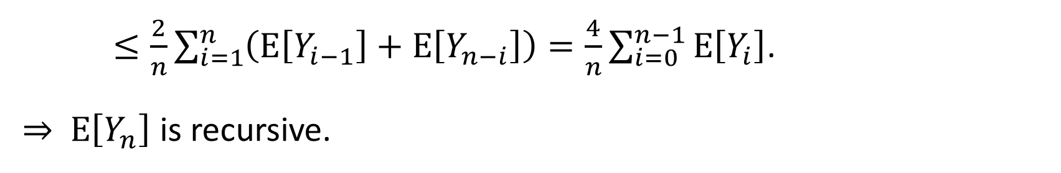

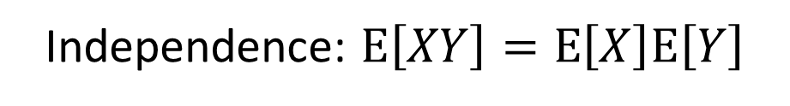
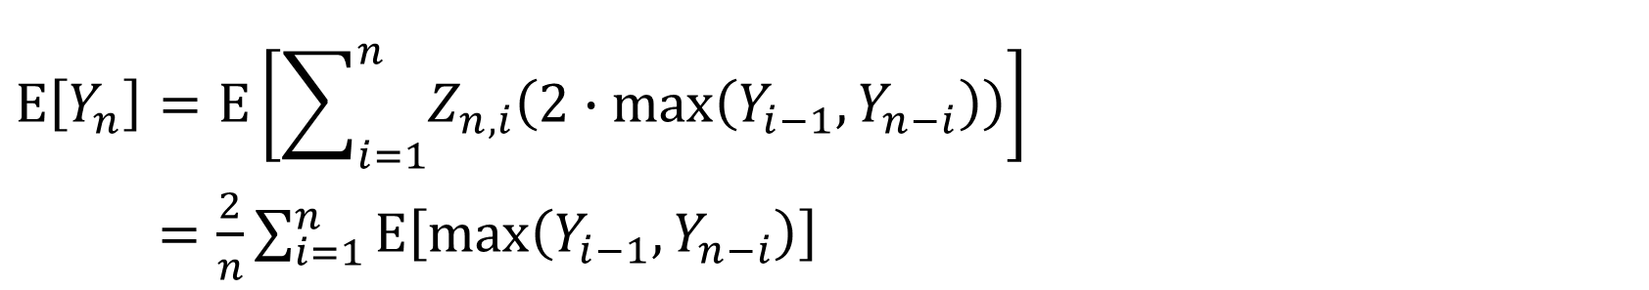
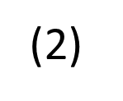
$Z_{n,i}$, $Y_{i−1}$ and $Y_{n−i}$ are all independent of each other, hence (1) ⇒
$E$linearity
(2)
Independence: $\text{E}\left[XY\right]=\text{E}\left[X\right]\text{E}\left[Y\right]$
$$E\left[Y_{n}\right]=E\left[\sum_{i=1}^{n}{Z_{n,i}\left(2∙max\left(Y_{i−1},Y_{n−i}\right)\right)}\right]$$
$=\frac{2}{n}\sum_{i=1}^{n}{E\left[\max\left(Y_{i−1},Y_{n−i}\right)\right]}$
$≤\frac{2}{n}\sum_{i=1}^{n}{\left(E\left[Y_{i−1}\right]+E\left[Y_{n−i}\right]\right)}=\frac{4}{n}\sum_{i=0}^{n−1}{E\left[Y_{i}\right]}$.
⇒ $E\left[Y_{n}\right]$ is recursive.
summands appear twice
(HW: Show $E\left[Y_{n}\right]≤\frac{1}{4}\left(\begin{matrix}n+3 \\ 3\end{matrix}\right)=O\left(n^{3}\right)$ by substitution, $\text{CLRS} \text{12.4}$).

Slide 7




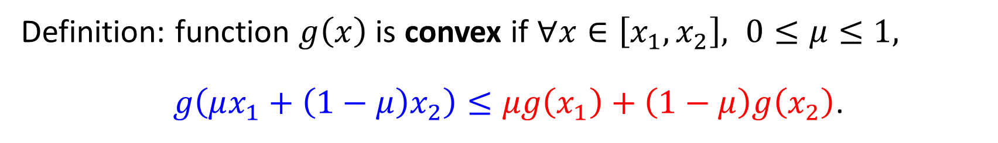
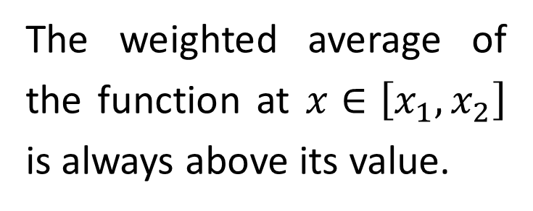
So far we obtained $\text{E}\left[2^{X_{n}}\right]=\text{E}\left[Y_{n}\right]=O\left(n^{3}\right)$, but $\text{E}\left[X_{n}\right]$ is interested.
Definition: function $g\left(x\right)$ is convex if $∀x∈\left[x_{1},x_{2}\right], 0≤μ≤1,$
$g\left(μx_{1}+\left(1−μ\right)x_{2}\right)≤μg\left(x_{1}\right)+\left(1−μ\right)g\left(x_{2}\right)$.
$$g\left(x\right)$$
The weighted average of the function at $x∈\left[x_{1},x_{2}\right]$ is always above its value.
$$x$$
$$x_{1}$$
$$x_{1}$$

Slide 8
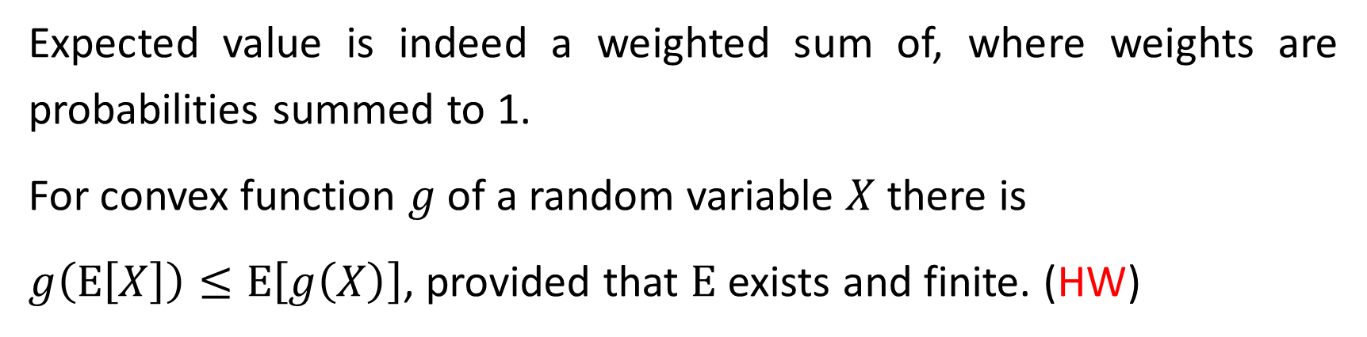

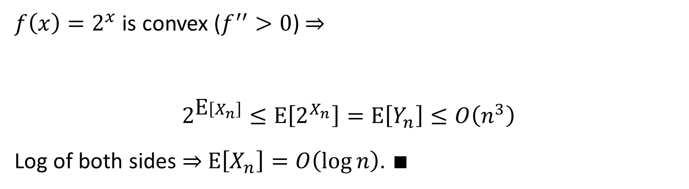
Expected value is indeed a weighted sum of, where weights are probabilities summed to 1.
For convex function $g$of a random variable $X$ there is
$g\left(\text{E}\left[X\right]\right)≤\text{E}\left[g\left(X\right)\right]$, provided that $\text{E}$ exists and finite. (HW)
$f\left(x\right)=2^{x}$ is convex ($f^{′′}>0$) ⇒
$$2^{\text{E}\left[X_{n}\right]}≤\text{E}\left[2^{X_{n}}\right]=\text{E}\left[Y_{n}\right]≤O\left(n^{3}\right)$$
Log of both sides ⇒ $\text{E}\left[X_{n}\right]=O\left(\log{n}\right)$. $∎$
$$g\left(\text{E}\left[X\right]\right)≤\text{E}\left[g\left(X\right)\right]$$

Slide 9
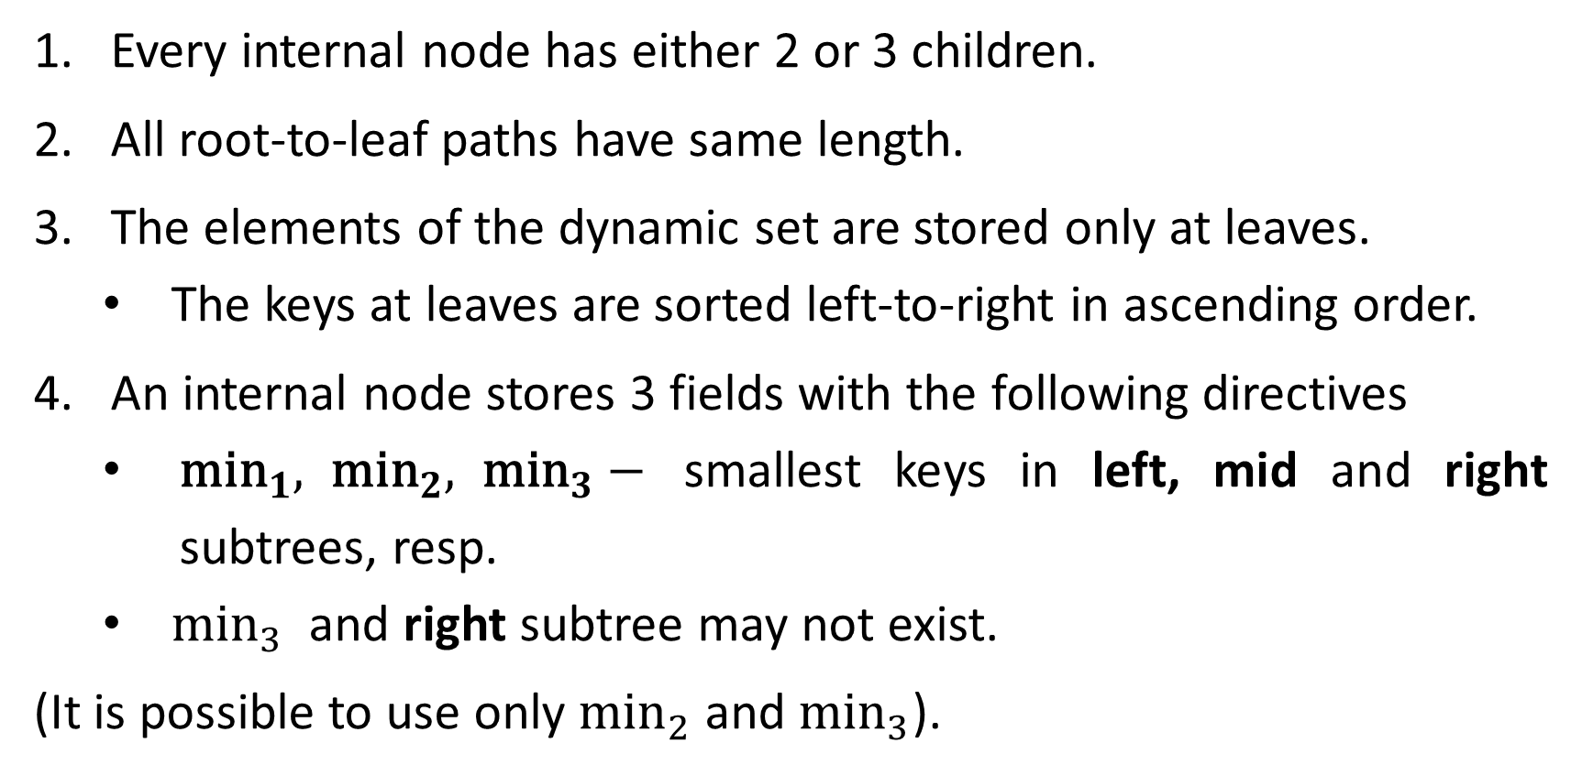
2-3 Trees
Every internal node has either 2 or 3 children.
All root-to-leaf paths have same length.
The elements of the dynamic set are stored only at leaves.
The keys at leaves are sorted left-to-right in ascending order.
An internal node stores 3 fields with the following directives
${\text{min}}_{1}, {\text{min}}_{2}, {\text{min}}_{3}−$ smallest keys in left, mid and right subtrees, resp.
${\text{min}}_{3}$ and right subtree may not exist.
(It is possible to use only ${\text{min}}_{2}$ and ${\text{min}}_{3}$).

Slide 10
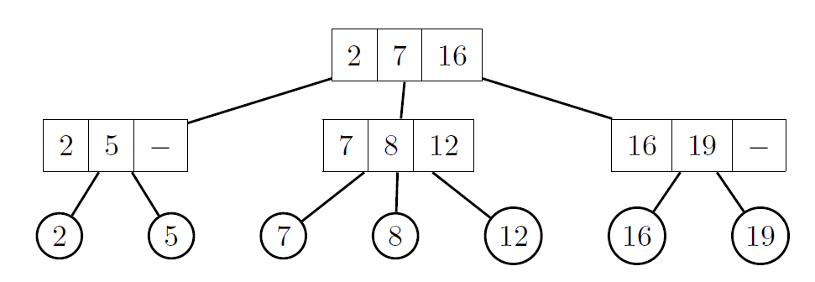
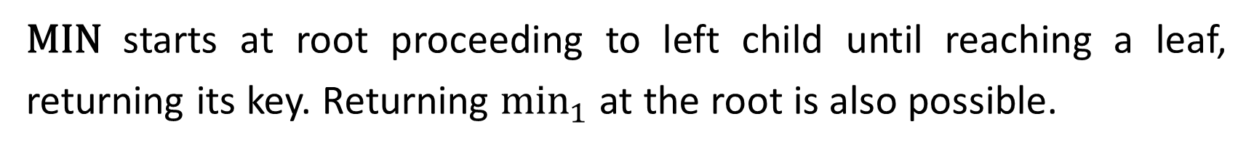
2-3 Tree Operations
$\text{MIN}$ starts at root proceeding to left child until reaching a leaf, returning its key. Returning ${\text{min}}_{1}$ at the root is also possible.
$\text{M}\text{AX}$ works similarly with right subtrees.

Slide 11
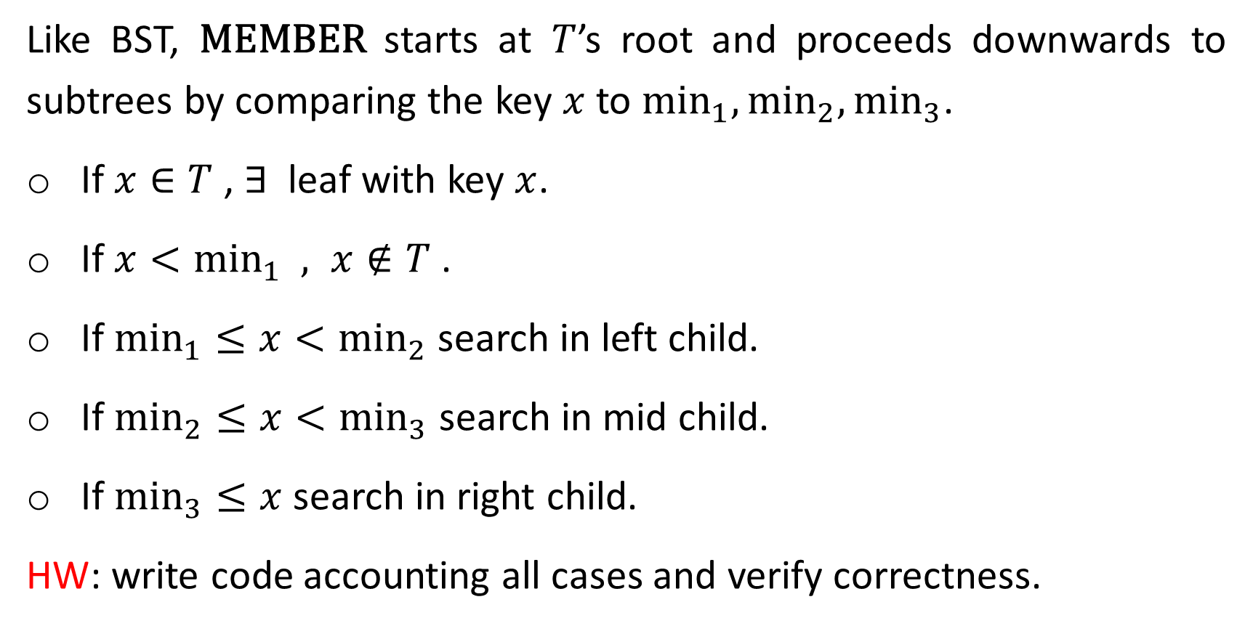
Like BST, $\text{MEMBER}$ starts at $T$’s root and proceeds downwards to subtrees by comparing the key $x$to ${\text{min}}_{1},{\text{min}}_{2},{\text{min}}_{3}$.
If $x∈T$ , $∃$ leaf with key $x$.
If $x<{\text{min}}_{1} , x∉T$.
If ${\text{min}}_{1}≤x<{\text{min}}_{2}$ search in left child.
If ${\text{min}}_{2}≤x<{\text{min}}_{3}$ search in mid child.
If ${\text{min}}_{3}≤x$ search in right child.
HW: write code accounting all cases and verify correctness.

Slide 12
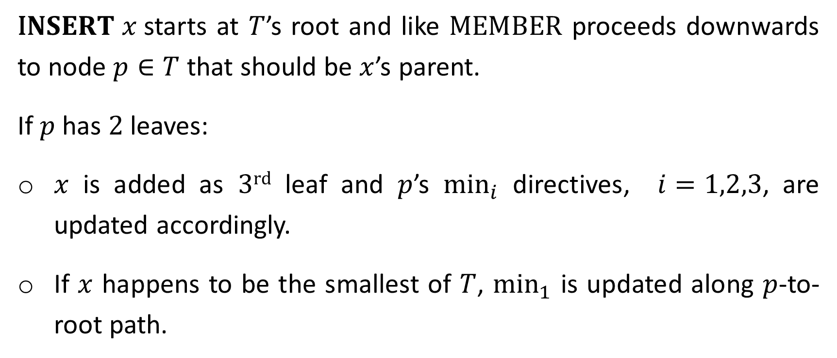
$\text{I}NSERT x$starts at $T$’s root and like $\text{MEMBER}$ proceeds downwards to node $p∈T$ that should be $x$’s parent.
If $p$ has $2$ leaves:
$x$ is added as $3\text{rd}$ leaf and $p$’s ${\text{min}}_{i}$ directives, $i=1,2,3$, are updated accordingly.
If $x$ happens to be the smallest of $T$, ${\text{min}}_{1}$ is updated along $p$-to-root path.

Slide 13
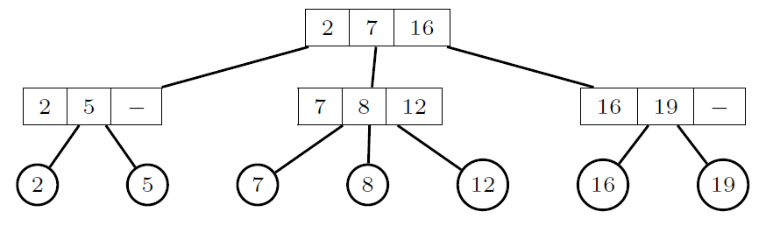
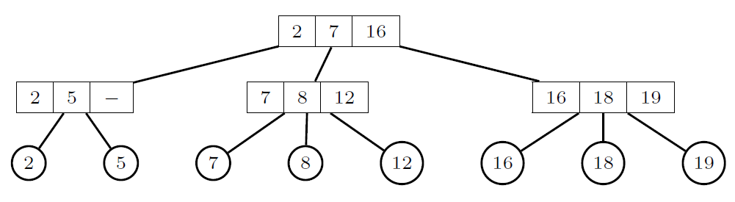


$$18$$
$$18$$

Slide 14
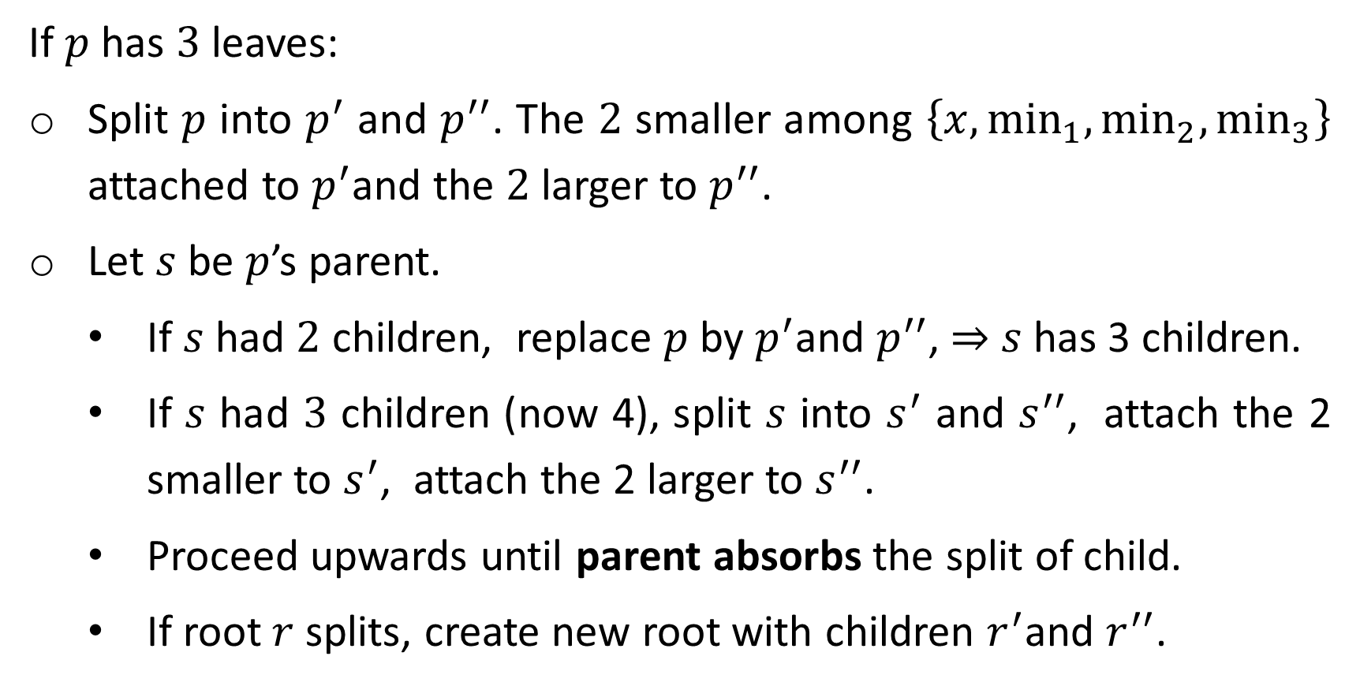
If $p$ has $3$ leaves:
Split $p$ into $p^{′}$ and $p^{′′}$. The $2$ smaller among $\left\{x,{\text{min}}_{1},{\text{min}}_{2},{\text{min}}_{3}\right\}$ attached to $p^{′}$and the $2$larger to $p^{′′}$.
Let $s$ be $p$’s parent.
If $s$ had $2$ children, replace $p$ by $p^{′}$and $p^{′′}$, ⇒ $s$has 3 children.
If $s$ had $3$ children (now 4), split $s$ into $s^{′}$ and $s^{′′}$, attach the 2 smaller to $s^{′}$, attach the 2 larger to $s^{′′}$.
Proceed upwards until parent absorbs the split of child.
If root $r$splits, create new root with children $r^{′}$and $r^{′′}$.

Slide 15
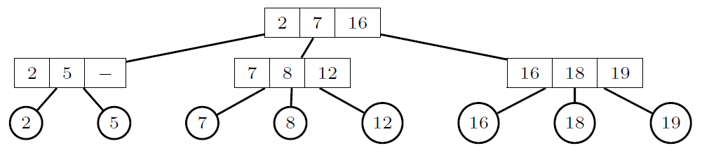
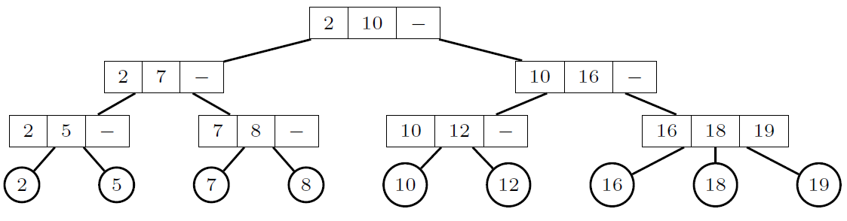








$$10$$
$$r$$
$$10$$
$$p$$
new root
$$r^{′}$$
split old root
$$r^{′′}$$
$$p^{′}$$
$$p^{′′}$$

Slide 16
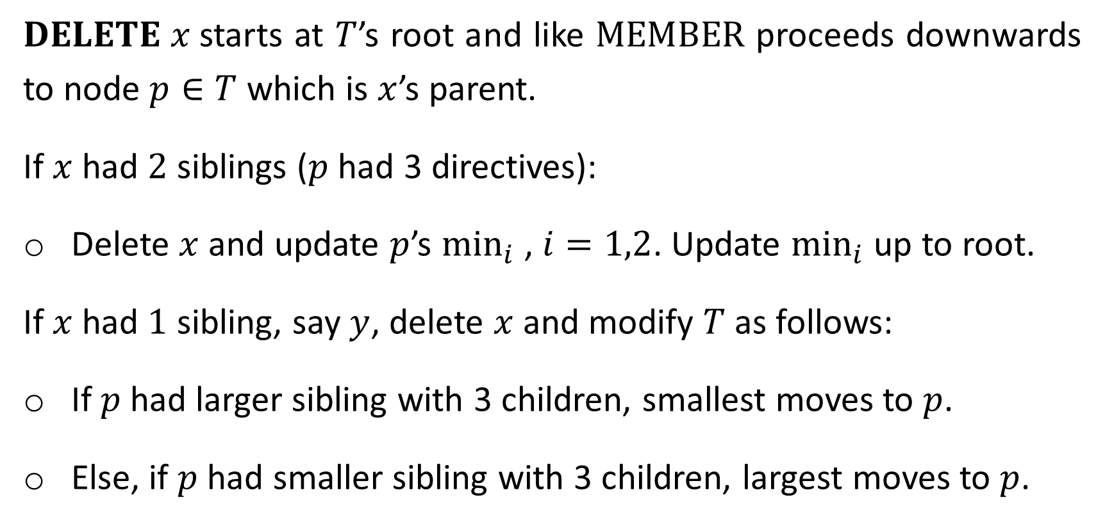
$DELETE x$starts at $T$’s root and like $\text{MEMBER}$ proceeds downwards to node $p∈T$ which is $x$’s parent.
If $x$ had $2$ siblings ($p$had 3 directives):
Delete $x$ and update $p$’s ${\text{min}}_{i}$ , $i=1,2$. Update ${\text{min}}_{i}$ up to root.
If $x$ had $1$ sibling, say $y$, delete $x$ and modify $T$as follows:
If $p$ had larger sibling with 3 children, smallest moves to $p$.
Else, if $p$ had smaller sibling with 3 children, largest moves to $p$.

Slide 17
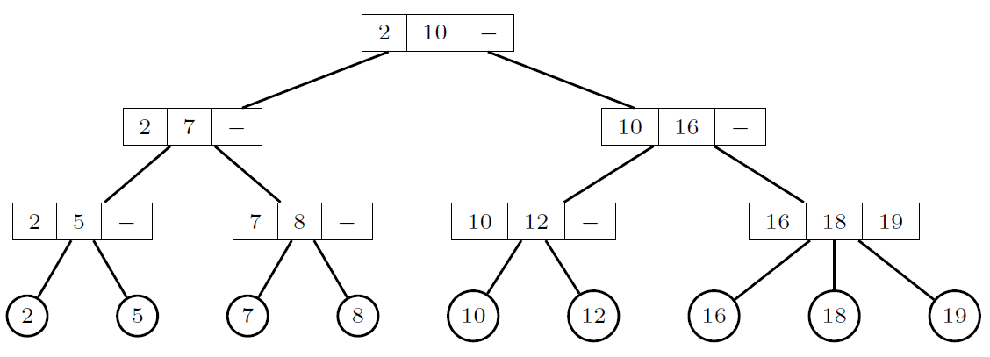
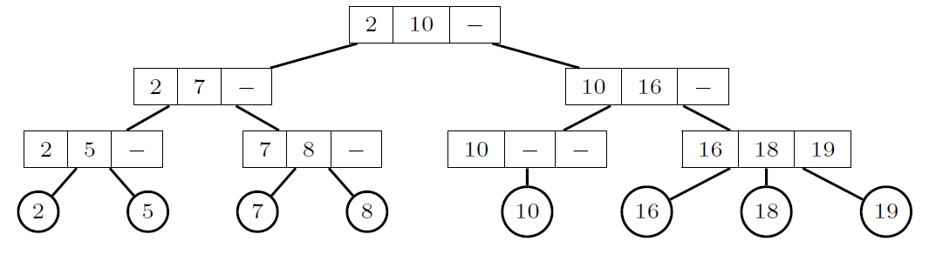
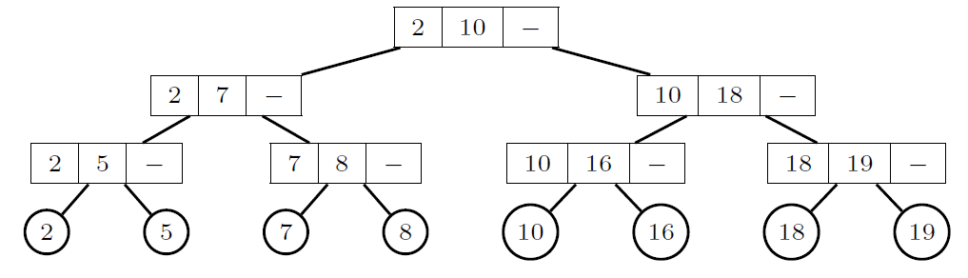









$$12$$
$$12$$
$$12$$
$$p$$
$$y$$
$$x$$
$$p$$
$$y$$
$$p$$
$$y$$

Slide 18
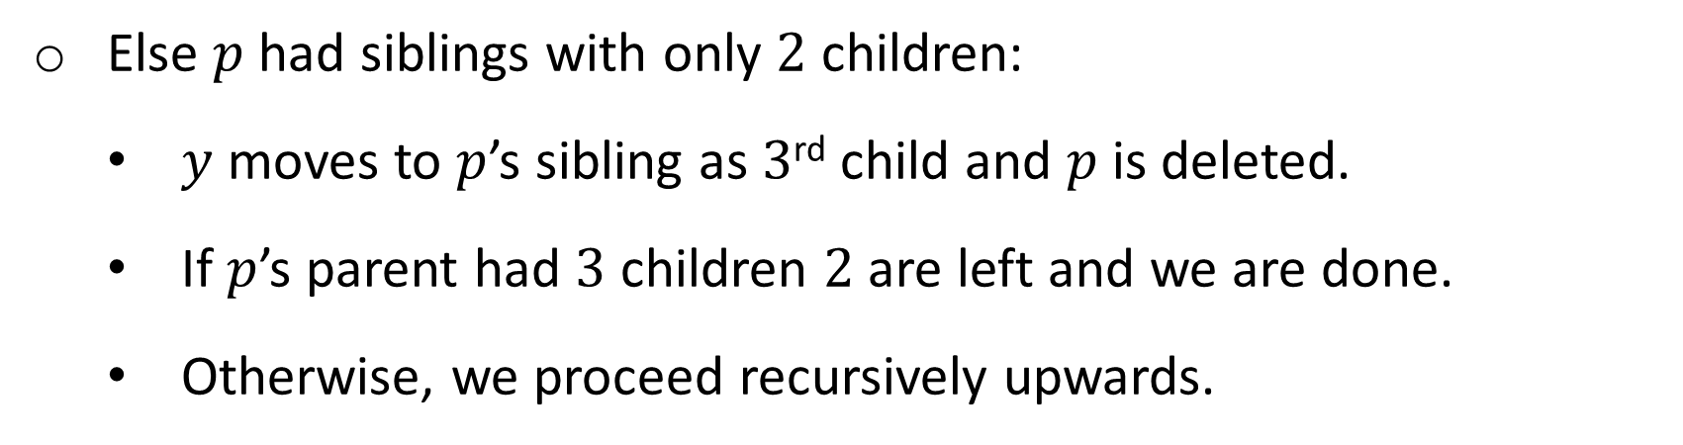
Else $p$ had siblings with only $2$ children:
$y$ moves to $p$’s sibling as $3$^{rd} child and $p$ is deleted.
If $p$’s parent had $3$ children $2$ are left and we are done.
Otherwise, we proceed recursively upwards.

Slide 19
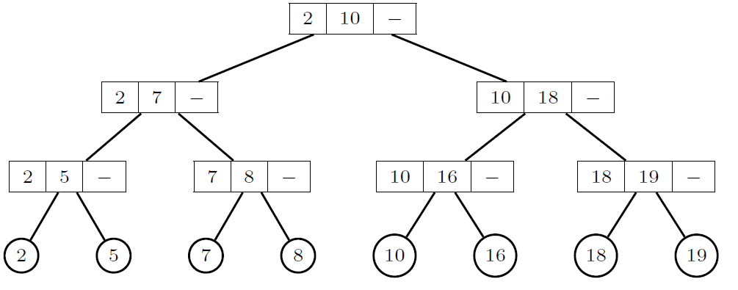
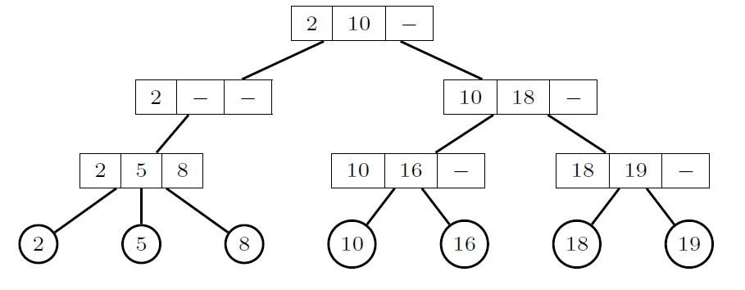
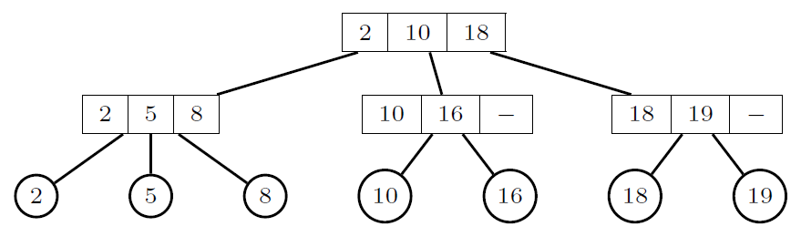








$$7$$
$$7$$
$$7$$
2 children yielding 3 subtrees merged in parent
$$p$$
$$x$$
$$y$$
imbalanced
$$?$$
$$y$$

Slide 20
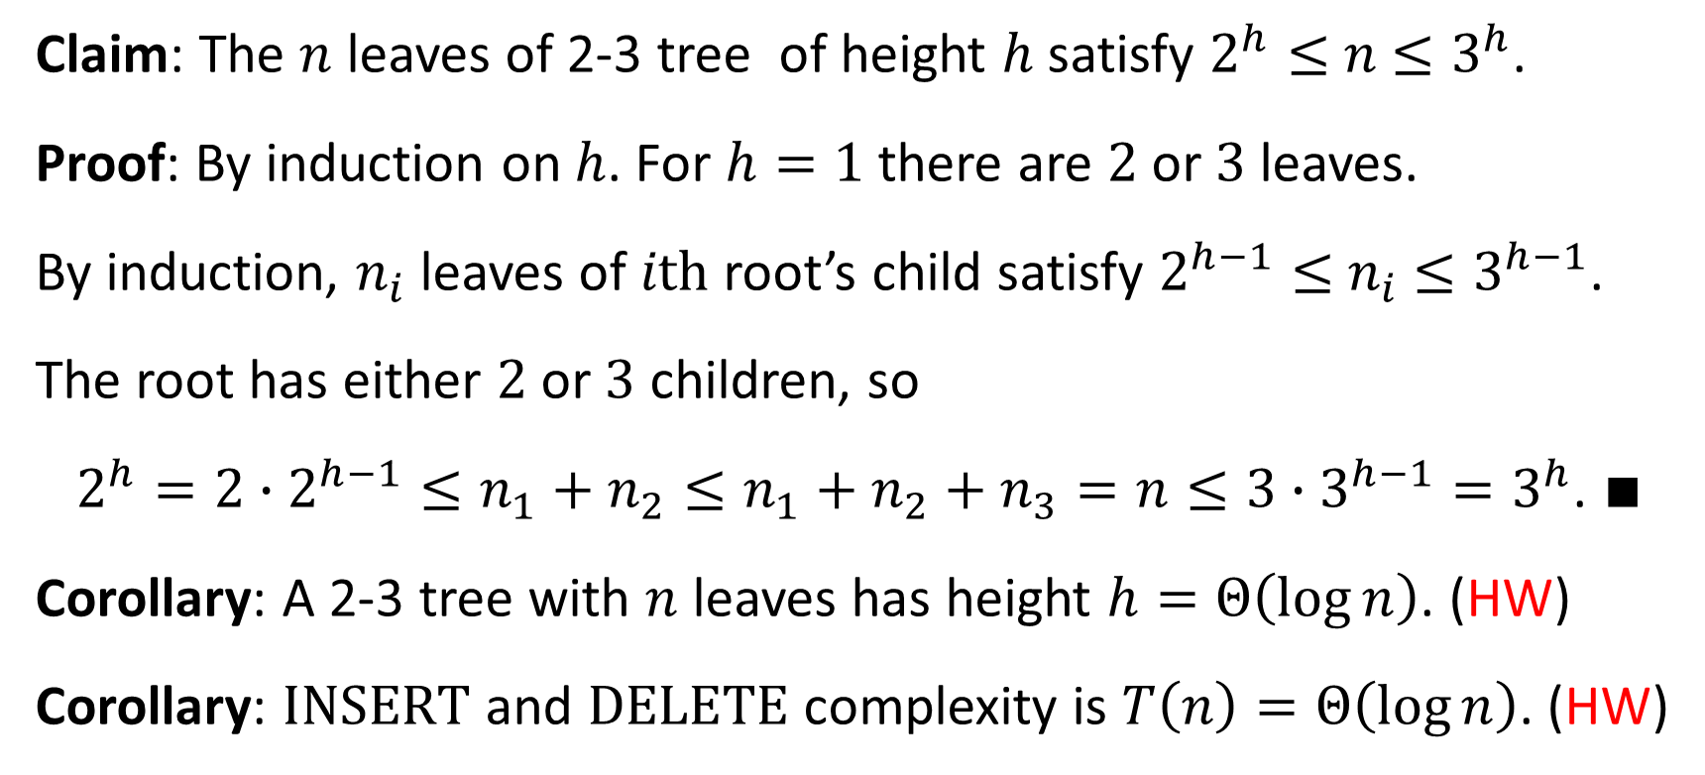
Complexities of Operations
Claim: The $n$ leaves of 2-3 tree of height $h$ satisfy $2^{h}≤$ $n$ $≤3^{h}$.
Proof: By induction on $h$. For $h=1$ there are $2$ or $3$ leaves.
By induction, $n_{i}$ leaves of $i\text{th}$ root’s child satisfy $2^{h−1}≤$ $n_{i}$ $≤3^{h−1}$.
The root has either $2$ or $3$ children, so
$2^{h}=2∙2^{h−1}≤n_{1}+n_{2}≤n_{1}+n_{2}+n_{3}=n≤3∙3^{h−1}=3^{h}$. ∎
Corollary: A 2-3 tree with $n$ leaves has height $h=Θ\left(\log{n}\right)$. (HW)
Corollary: $\text{INSERT}$ and $\text{DELETE}$ complexity is $T\left(n\right)=Θ\left(\log{n}\right)$. (HW)

Slide 21
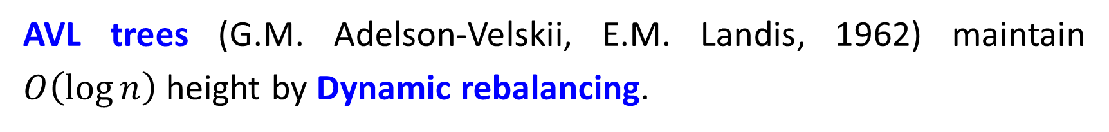
AVL Trees
AVL trees (G.M. Adelson-Velskii, E.M. Landis, 1962) maintain $O\left(\log{n}\right)$ height by Dynamic rebalancing.
$$0$$
$$8$$
$$1$$
$$5$$
$$11$$
$$2$$
$$3$$
$$7$$
$$12$$
$$10$$
$$3$$
$$2$$
$$4$$
$$6$$
$$9$$
$$4$$
$$1$$
Balance invariance: left and right subtrees depth differ at most by 1.

Slide 22
Worst (imbalanced) AVL: 1 height diff occurs at all nodes. Otherwise leaves could be dropped without harming the invariance.
Let $N\left(h\right)$ be min number of nodes in $h$-height AVL tree.
W.l.o.g let $N\left(h−1\right)$ min nodes in left subtree, and $N\left(h−2\right)$ min in right subtree. Then
$$N\left(h\right)=N\left(h−1\right)+N\left(h−2\right)+1$$
$$N\left(h−2\right)$$
$$N\left(h−1\right)$$

Slide 23
$N\left(h\right)=1+N\left(h−1\right)+N\left(h−2\right)>2N\left(h−2\right)$.
Recursion solved by substituting $N\left(h\right)=λ^{h}$. Then,
$λ^{h}>2λ^{h−2}$ ⇒ $λ^{2}>2$ ⇒ $λ>2^{1/2}$ ⇒ $N>2^{h/2}$. Taking log,
$h<2\log{N}$.
The above is the worst situation, bounding any tree satisfying AVL balance invariance.
(Actually $h<1.44\log{N}$, but proof is more complex).

Slide 24
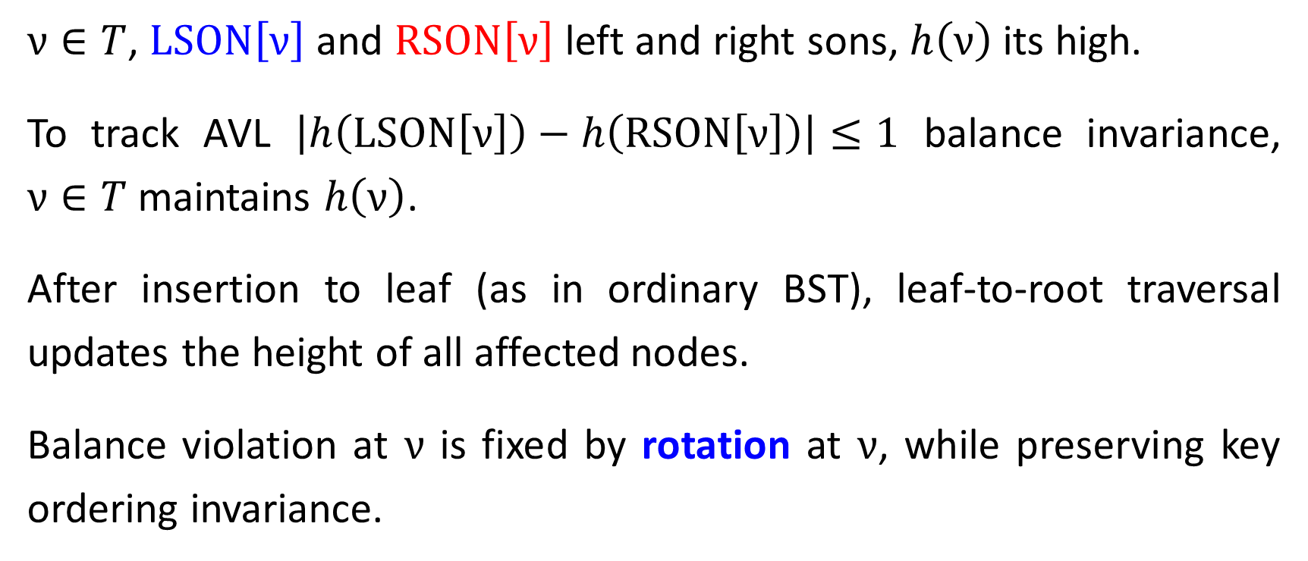
Insertion in AVL Tree
$ν∈T$, $\text{LSON}\left[ν\right]$ and $\text{R}\text{SON}\left[ν\right]$ left and right sons, $h\left(ν\right)$ its high.
To track AVL $\left|h\left(\text{LSON}\left[ν\right]\right)−h\left(\text{R}\text{SON}\left[ν\right]\right)\right|≤1$ balance invariance, $ν∈T$ maintains $h\left(ν\right)$.
After insertion to leaf (as in ordinary BST), leaf-to-root traversal updates the height of all affected nodes.
Balance violation at $ν$ is fixed by rotation at $ν$, while preserving key ordering invariance.

Slide 25
Re - balance takes place depending where leaf $μ$inserted.
By single rotation if inserted in $\text{LSON}\left[\text{LSON}\left[ν\right]\right]$ or $\text{R}\text{SON}\left[\text{RSON}\left[ν\right]\right]$.
Balance violation
$$ν$$
right rotation
$$ω$$
$$ν$$
$$ω$$
$$Z$$
$$X$$
$$Y$$
$$Z$$
$$Y$$
$$h$$
$$h+1$$
$$X$$
$$h$$
$$h$$
$$h$$
$$μ$$
$$h+1$$
$$μ$$

Slide 26
By double rotation if inserted in $\text{LSON}\left[\text{RSON}\left[ν\right]\right]$ or $\text{RSON}\left[\text{LSON}\left[ν\right]\right]$.
Balance violation
$$ν$$
2nd
$$ν$$
$$ω$$
$$ω$$
1st
$$Z$$
$$Z$$
$$X$$
$$h$$
$$X$$
$$h$$
$$Y$$
$$γ$$
$$h$$
$$h$$
$$h+1$$
$$μ$$
$$V$$
$$W$$
$$h$$
$$μ$$
$$h$$
$$μ$$
Right rotation alone does not solve the imbalance.
$Y$ subtree splits into $V$ and $W$. Either $μ∈V$ or $μ∈W$.

Slide 27
Balance restored by two rotations: 1st left, 2nd right.
$$ν$$
after left rotation
$X$, $V$, $W$, $Z$ key ordering preserved.
$$γ$$
$$Z$$
$$W$$
$$h$$
$$ω$$
$$h$$
after right rotation
$$X$$
$$V$$
$$γ$$
$$h$$
$$h$$
$$ω$$
$$ν$$
$$X$$
$$V$$
$$W$$
$$Z$$
$$h$$
$$h$$
$$h$$
$$h$$

Slide 28
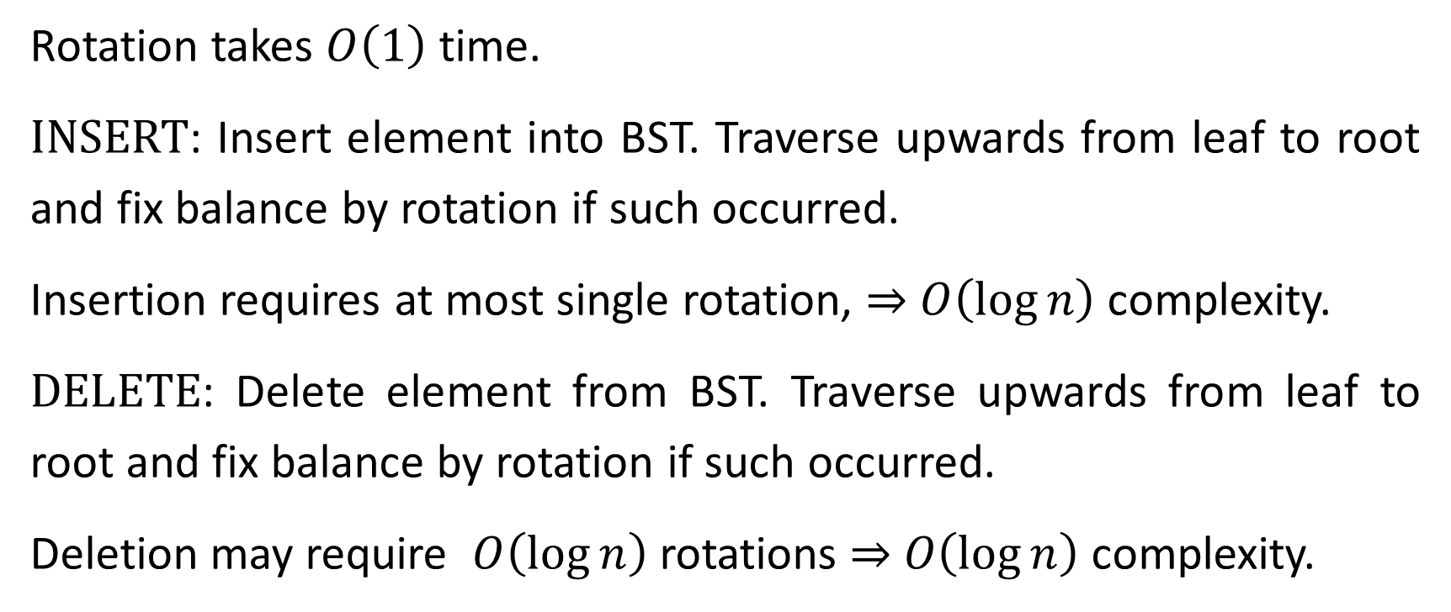
Complexities of Operations
Rotation takes $O\left(1\right)$ time.
INSERT: Insert element into BST. Traverse upwards from leaf to root and fix balance by rotation if such occurred.
Insertion requires at most single rotation, ⇒ $O\left(\log{n}\right)$ complexity.
DELETE: Delete element from BST. Traverse upwards from leaf to root and fix balance by rotation if such occurred.
Deletion may require $O\left(\log{n}\right)$ rotations ⇒ $O\left(\log{n}\right)$ complexity.

